Slide 1
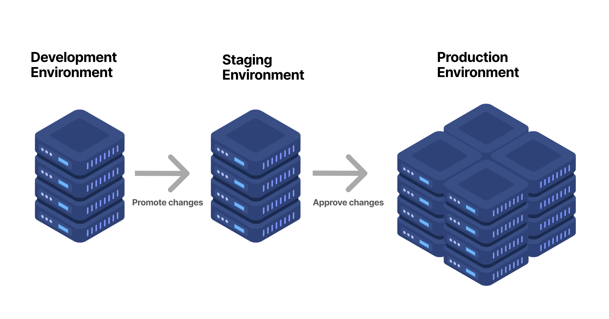
Technical Challenge - RapidGoat
Reda AABBAR

Slide 2
TABLE OF CONTENTS
01
Introduction
02
Solution Overview

Slide 3
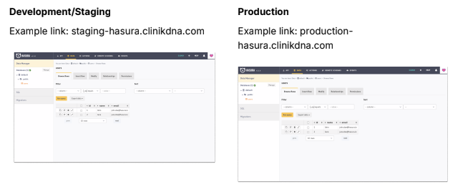
Introduction
Problem: Identifying and avoiding accidental modifications in staging or production environments.
Visually similar

Slide 4
Solution Overview
the links are different

Slide 5


staging-hasura.clinikdna.com
Alert that we are in the staging environment
Detects URL
*-hasura.clinikdna.com
production-hasura.clinikdna.com
Alert that we are in the production environment
Chrome Extension

